Slide 2
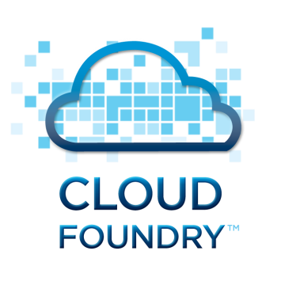
Pivotal CF
The Platform for a New Era of Software Innovation
Alberto Flores
Sr. Field Engineer
Pivotal Federal

Slide 3

Demonstration of Pivotal CF
Operations Manager & Web Console
Ease of Deployment: cf push
Ease of Scalability: cf scale
Service Binding: cf bind-service
High Availability and Self-Recovery
Use Case: DevOps
Notes:
For the next few minutes, I’m going to give you a tour of Pivotal CF, the enterprise ready version of CloudFoundry.
This includes 2 web interfaces
- Operations Manager (which is the interface for the operators of the platform) and
- Web Console (which is the interface for the “developers”, those who deploy applications in the cloud).
I will also show the ease of operations in CloudFoundry. In particular, you’ll see how the “cf push” and “cf scale” operations can greatly enhance the agility of application deployment and scalability respectively.
In addition, I’ll demonstrate the flexible “service binding” model that the CloudFoundry platform provides to deployed applications.
As discuss before, CloudFoundry implements 4 different levels of HA (High Availability). I’ll demonstrating one of them as the platform is able to recover a failed applications.
And Lastly, we’ll review a simple DevOps use case to illustrate how the PaaS is a key component of innovation.

Slide 4
Operations Manager
&
Web Console
Notes:
Pivotal CF provides 2 web interfaces to CloudFoundry that makes use of the platform simple.
One is called “Operations Manager”. This is an interface for the operators of CloudFoundry. Here, operators configure resources such as:
VMs,
LDAP integration,
IPs of external resources,
Security pools,
Load balancers,
As well as any other enterprise component needed by your software enterprise.
All of these components and many more are available in a centralized interface so that configuration of the “platform” is transparent to every operator. This means, every change that occurs in the platform is logged and can be subject to your audit requirements. Traditionally, this is another pain point generated by custom and complex scripts that only a few can understand.
The second interface I’d like to show is the developer’s “web console”. This is a simple graphical interface designed to be a source of references for developers and the applications they deploy into the “cloud” managed by the “platform”. In this console, developers can see:
The organization they are assigned and the spaces they have access.
The services available within the platform
All Applications currently deployed within the given workspace
Centralized view relevant to an application lifecycle in the deployed environment. This includes:
Status of the application
Change events
Log entries produced by the application
Services bound
Operation Console to modify resource allocation at runtime.

Slide 5
Ease of Deployment: cf push
Notes:
What we have here is a “java” web based application, using popular frameworks such as Spring and Maven.

Slide 6
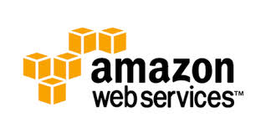
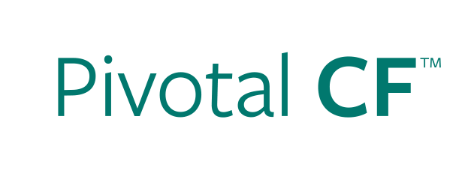
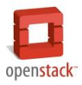


Deploying an Application
IaaS versus PaaS
Provision VM
Install Application Runtime
Deploy Application
cf push
Configure Load Balancer
Configure SSL Termination
Configure Service Connectivity
Configure Firewall
Notes:
As it was mentioned a minute ago, traditional pain points of software innovation include both:
- Complicated Processes and Procedures that slow down innovation.
- Developer Frustration in the lack of tooling to solve problem.
“Platform as a Service” can solve this problem by automating the processes associated with these tasks.

Slide 7
Ease of Scalability: cf scale

Slide 8
Scaling an Application
IaaS versus PaaS
Provision New VM
Install Application Runtime
Deploy Application
cf scale
Configure Load Balancer / Update Route
Configure Service Connectivity
Configure Firewall
Notes:
Highlight that not only are the steps longer in IaaS, but often there are multiple groups involved (ie, Dev, Operations, etc).
Management of configuration information is often manual in IaaS (though not always).
Explain that for non-virtualized customers, the steps are even greater.

Slide 9
Service Binding:
cf bind-service

Slide 10
Sample USPTO App in Cloud Foundry
Cloud Foundry App Space
Cloud Foundry Services Marketplace
USPTO Search Application
Data.gov Crawler
Patent Data Service
Java Spring Worker Code
Patent Search App
Java Spring App Code
Notes:
Logical architecture for USPT

Slide 11
HA and Self-Recovery

Slide 12
Use Case: DevOps

Slide 13



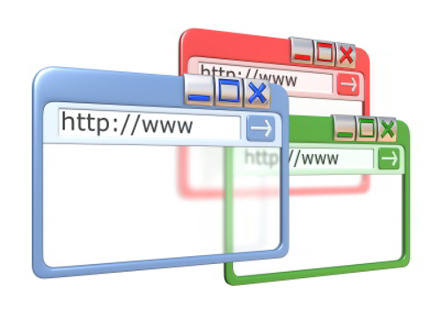
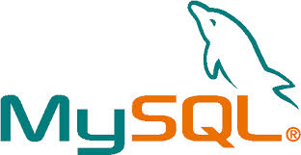
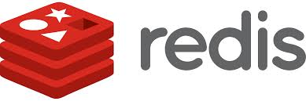
Multi-Cloud DevOps
It’s about getting things done, not “where” it’s done.
Development & Testing
Xen Hypervisor
Public Cloud
Multiple Iterations
Testing (QA, UAT, etc)
Production
ESXi
Private Cloud
Enterprise Monitoring
vSphere Integration
Notes:
As mentioned before, cloud deployment (IaaS) today can lead to the new Silos in software.
CloudFoundry provides a Platform that makes these cloud behave the same with zero code changes.
This means, there are “zero” vendor lock-in to any IaaS (no proprietary vendor API used).

Slide 14
Demonstration of Pivotal CF
Operations Manager & Web Console
Ease of Deployment: cf push
Ease of Scalability: cf scale
Service Binding: cf bind-service
High Availability and Self-Recovery
Use Case: DevOps

Slide 15
Questions

Slide 17
Questions

Slide 18
Pivotal CF: Enterprise Grade SW Delivery
Simple & Comprehensive
End to end platform to iterate quickly and build highly scalable cloud apps
IT Ops automation with no scripts, no templates, no config headaches
Easy to use management dashboard
Scalable & Efficient
Elastic scale of PaaS capacity and applications through simple interfaces or scripting
Higher application instance density on the same IaaS footprint through advanced containerization
Governed & Secure
Individual and team-based roles and permissions
Easy integration w/ 3rd party tools and agents
Extensible
Independent of the IaaS provider, the runtime languages supported & the brokered services
Simple APIs ensure easy extension and customization
Highly Available
Built in health monitoring and management of applications and the platform
Zero downtime deploys/updates of the platform and applications
Notes:
The previous 2 slides showed the basics of CF vs IaaS, this is a more detailed overview of what else you get w/ Pivotal CF

Slide 19
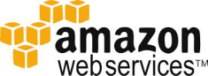

Pivotal CF:
The Platform for a New Era of Software Innovation
Integrated operator functions
Ready Middleware Services
Auto deploy and scale
Instant Dynamic Routing
Streaming Logging Agg
ID/team/RBAC/Policy
APM, Auto-scaling
Ready integration
Four layers of built-in Availability
Auto-detect runtimes, frameworks
“Push and it works” model
CF Push [.WAR]
CF Push [Docker]
CF Push [.ASP]
Elastic Pivotal HD
HAWQ Analytics
Mobile Push
Mobile Sync
Mobile API
MySQL HA
Redis
Rabbit MQ
Elastic Search
Cassandra
Jenkins (Partner)
Deploy, Operate, Update, Scale on any Infrastructure
….and more

Slide 20


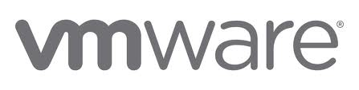




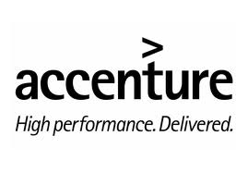


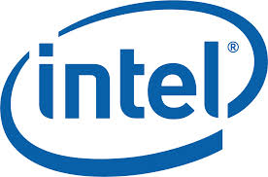







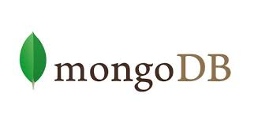
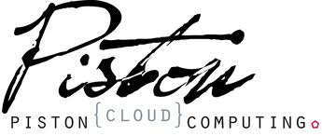
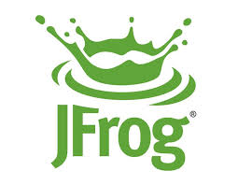



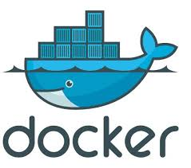

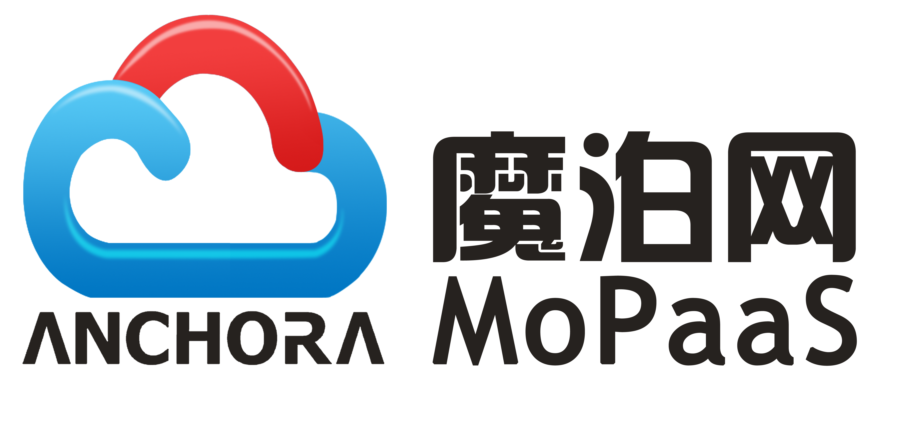
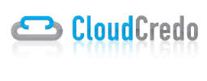




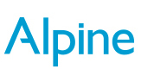
The Cloud Foundry OSS Foundation
Platinum
Gold
Announcing more soon
Silver
Notes:
Largest Open source PaaS Ecosystem. Billions committed to the technology
Global SPs are “all in”: AT&T, Verizon, NTT, Swisscom, CenturyLink, Telus, etc.

Slide 21

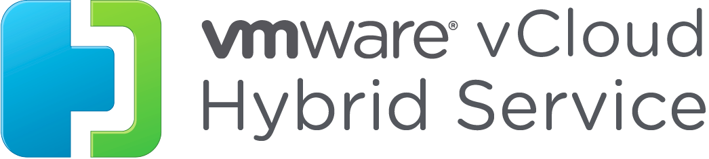
Pivotal CF: Cloud Independent Enterprise PaaS
Simple, Developer Friendly Commands & API
Operational Benefits for Every Application
Built-in and Ecosystem Services
Auto-detect frameworks
“Push and it works”
.WAR
Dockerfile
.NET
Simple service binding
Agile Microservices
Instant dynamic routing
Log stream aggregation
Access controls & policies
Built-in Containerization
APM & Operational metrics
4 Layers of High Availability
Applications
Rabbit MQ
MySQL HA
Cassandra
Elasticsearch
Jenkins (CI)
Memcached
MongoDB
Neo4j
Redis
Riak CS
Data/Analytics
Elastic Hadoop
HAWQ
GemFire XD
Mobile
Push Notification
Data Synch
API Gateway
App-Instance
Availability Zone
Process
Virtual Machine
Easy to add and customize
Easy to add and customize
Deploy, Operate, Update & Scale with minimal downtime on Any IaaS
….and more
Notes:
Building the Pivotal CF story via animation
Developer experience - where we started from and keep improving
Operation benefits - When we started selling to enterprise customer beyond a cloud service, both at the Cloud Ops and Application Ops level
3 groups of build-in services (Pivotal and ecosystem) – Apps, Data/Analytics & Mobile. All Services are both deployed in a consistent / cloud in depended way by Cloud Ops and exposed to App Developer for easy binding to applications via the ERS marketplace
All 3 pillars (Dev, Ops, Services) enjoy a common operational, continuous delivery and scale on any IaaS without app/service code of config changes

Slide 22















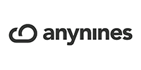

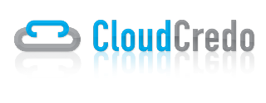

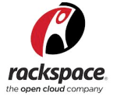






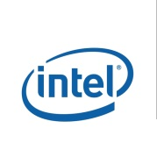
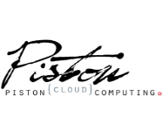



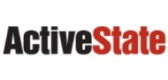
Incredible Cloud Foundry Ecosystem

Slide 23
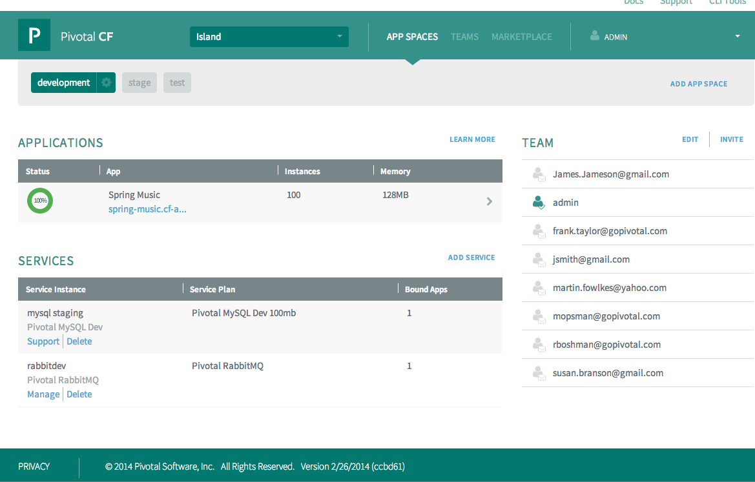
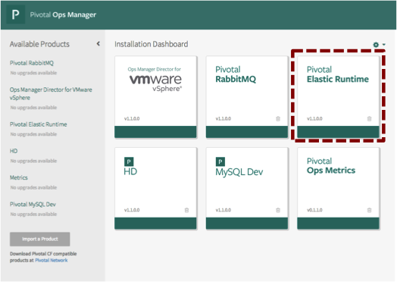
…to Hours and Minutes
Developer
Operator
Auto-select runtimes
Deploy app
Select and bind Services
Scale app
Establish infrastructure
Provision
Add capacity
Control Auth, Policies, HA
App Deployment: 30-90 seconds
Cloud Deployment: 2-4 hours

